Slide 1
Camel routing
COURSEWARE

Slide 2
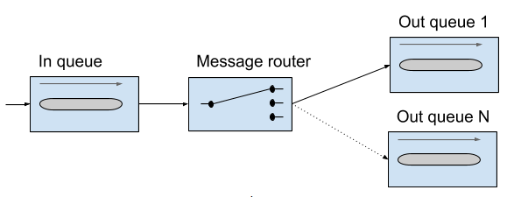
Camel routing
In the context of enterprise messaging systems, routing is the process by which a message is taken from an input queue and, based on a set of conditions, sent to one of several output queues. The input and output queues are unaware of the conditions in between them.
Notes:
A message router consumes messages from an input channel and, depending on a set of conditions, sends the message to one of a set of output channels.

Slide 3
What is JMS?
Java Message Service (JMS) is a Java API that allows you to create, send, receive, and read messages. It also mandates that messaging is asynchronous and has specific elements of reliability, such as guaranteed and once-and-only-once delivery.
Message consumers and producers talk to one another through an intermediary-a JMS destination. A destination can be either a queue or a topic.
Queues are strictly point-to-point; each message has only one consumer.
Topics operate on a publish/subscribe scheme; a single message may be delivered to many consumers if they’ve subscribed to the topic.

Slide 4
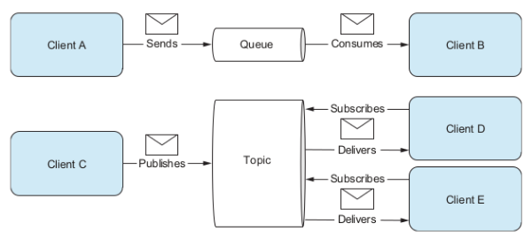

Slide 5
Configuring JMS
To connect Camel to a specific JMS provider, you need to configure Camel’s JMS component with an appropriate ConnectionFactory.
In the case of Apache ActiveMQ, you can create an ActiveMQConnectionFactory that points to the location of the running ActiveMQ broker:
ConnectionFactory connectionFactory = new ActiveMQConnectionFactory("vm://localhost");
The vm://localhost URI means that you should connect to an embedded broker named localhost running inside the current JVM.
Notes:
Apache ActiveMQ is one of the most popular open source JMS providers.
The vm transport connector in ActiveMQ creates a broker on demand if one isn’t running already, so it’s handy for quickly testing JMS applications; for production scenarios, it’s recommended that you connect to a broker that’s already running.

Slide 6
Configuring JMS
When you create your CamelContext , you can add the JMS component.
CamelContext context = new DefaultCamelContext();
context.addComponent("jms", JmsComponent.jmsComponentAutoAcknowledge(connectionFactory));
Lastly we need to add maven dependency.
<dependency>
<groupId>org.apache.camel</groupId>
<artifactId>camel-jms</artifactId>
<version>2.20.1</version>
</dependency>

Slide 7
Using URIs to specify destination
After the JMS component is configured, you can start sending and receiving JMS messages at your leisure.
Let’s say you want to send a JMS message to the queue named orders . The URI in this case would be as follows:
activemq:queue:orders
The jms prefix indicates that you’re using the JMS component you configured before. By specifying queue, the JMS component knows to send to a queue named orders.
.to("activemq:queue:orders")

Slide 8
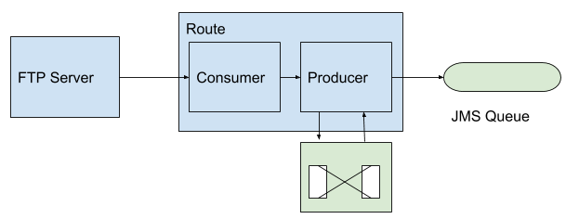
FTP to JMS example
We’ll see an example where we connect to FTP, specify a directory from which we want to copy files from and then we copy them over to the JMS queue.

Slide 9
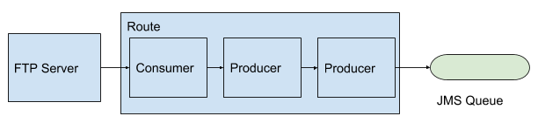
Adding a processor
Gives you full access to the message exchange, letting you do pretty much whatever you want with the payload or headers.
from(ftp://somegcloudip/orders?username=admin&password=secret").process(new Processor() {
public void process(Exchange exchange) throws Exception {
System.out.println("We just downloaded: " + exchange.getIn().getHeader("CamelFileName"));
}
}).to("activemq:orders");

Slide 10
Sending to dynamic endpoints
Endpoint URIs like the JMS one are evaluated just once when Camel starts up, so they’re static entities in Camel.
All good if we know the destination beforehand, but what if we don’t?
What if we need to determine at runtime?
For example, say you want to make the endpoint URI point to a destination name stored as a message header.
.toD("activemq:queue:${header.myDest}");

Slide 11
Using the Properties Component
Camel has a Properties Component to support externalizing properties defined in the routes (and elsewhere).
To ensure that the property placeholder is loaded and in use as early as possible, you have to configure PropertiesComponent when CamelContext is created:
CamelContext context = new DefaultCamelContext();
PropertiesComponent prop = camelContext.getComponent("properties", PropertiesComponent.class);
prop.setLocation("classpath:system-properties.properties");
In the system-properties.properties file, you define the externalized properties as key-value pairs:
myDest=pathToUse

Slide 12
Route builder using Properties component
return new RouteBuilder() {
@Override
public void configure() throws Exception {
from("file:src/data?noop=true").to("activemq:{{myDest}}");
}
};

Slide 13
Using raw values in endpoint URIs
Sometimes values you want to use in a URI will make the URI itself invalid. Take, for example, an FTP password of ++%%w?rd. This would break it as the symbols are reserved characters.
Camel’s solution is to allow “raw” values in endpoint URIs that don’t count toward URI validation.
from("ftp://someurl.com/orders?username=admin&password=RAW(++%%w?rd)")

Slide 14
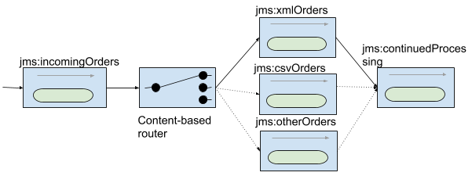
Using a content-based router

Slide 15
Using a content-based router
Content-based router (CBR) is a message router that routes a message to a destination based on its content. The content could be a message header, the payload data type, or part of the payload itself pretty much anything in the message exchange.
from("jms:orders")
.choice()
.when(header("CamelFileName").endsWith(".xml"))
.to("activemq:xmlOrders")
.when(header("CamelFileName").endsWith(".csv"))
.to("activemq:csvOrders");

Slide 16
Using the otherwise clause
from("jms:orders")
.choice()
.when(header("CamelFileName").endsWith(".xml"))
.to("activemq:xmlOrders")
.when(header("CamelFileName").regex("^.*(csv|csl)$"))
.to("activemq:csvOrders")
.otherwise()
.to("activemq:otherOrders");

Slide 17
Routing after a content-based router
from("jms:orders")
.choice()
.when(header("CamelFileName").endsWith(".xml"))
.to("activemq:xmlOrders")
.when(header("CamelFileName").regex("^.*(csv|csl)$"))
.to("activemq:csvOrders")
.otherwise()
.to("activemq:otherOrders")
.end()
.to("activemq:continuedProcessing");

Slide 18
Routing with filter
from("ftp://test.rebex.net/pub/example?username=demo&password=password")
.filter(header("CamelFileName").endsWith(".txt"))
.to("activemq:queue:txtOrders");
Notes:
If we had test orders that we didn’t want but still had to have them.

Slide 19
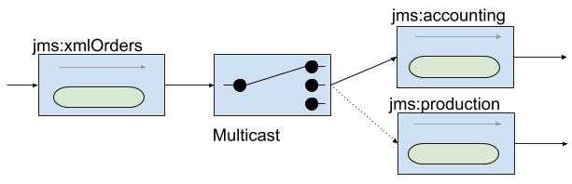
Multicasting
If we needed to send the same message to multiple destinations we can use multicast.
from("activemq:xmlOrders").multicast().to("activemq:accounting", "activemq:production");

Slide 20
Using parallel multicasting
Sending messages in parallel by using the multicast involves only one extra DSL method: parallelProcessing.
from("activemq:xmlOrders")
.multicast()
.parallelProcessing()
.to("activemq:accounting", "activemq:production");
Notes:
By default, the multicast will continue sending messages to destinations even if one fails. In your application, though, you may consider the whole process as failed if one destination fails.

Slide 21
Stopping the multicast on exception
from("activemq:xmlOrders")
.multicast()
.stopOnException()
.to("activemq:accounting")
.to("activemq:orders");
from("activemq:accounting")
.throwException(Exception.class, "I failed!")
.log("Accounting received order: ${header.CamelFileName}")
.to("activemq:orders");
Notes:
if the order failed to send to the accounting queue, it might take longer to track down the order from production and bill the customer. To solve this problem, you can take advantage of the stopOnException feature of the multicast.

Slide 22
Using recipient list
from("jms:xmlOrders")
.setHeader("recipients", method(RecipientsBean.class, "recipients"))
.recipientList(header("recipients"));

Slide 23
Using recipient list
public class RecipientsBean {
public String[] recipients(@XPath("/order/@customer") String customer) {
if (isGoldCustomer(customer)) {
return new String[]{"activemq:accounting", "jmactivemqs:production"};
} else {
return new String[]{"activemq:accounting"};
}
}
private boolean isGoldCustomer(String customer) {
return customer.equals("honda");
}
}

Slide 24
Using wiretap
Often in enterprise applications, inspecting messages as they flow through a system is useful and necessary.
from("activemq:orders")
.wireTap("activemq:orderAudit")
.choice()
.when(header("CamelFileName").endsWith(".xml")).to("activemq:xmlOrders")
.when(header("CamelFileName").regex("^.*(csv|csl)$")).to("activemq:csvOrders")
.otherwise()
.to("activemq:otherOrders");
Notes:
A wire tap is a fixed recipient list that sends a copy of a message traveling from a source to a destination to a secondary destination without affecting the actual route.

Slide 25
Thank you
QA HOPES YOU ENJOYED YOUR COURSE,
AS MUCH AS WE ENJOYED TEACHING YOU.

